Slide 1

Note: The data and information in this document is reflective of a hypothetical situation and client. This document is to be used for KPMG Virtual Internship purposes only.
Sprocket Central Pty Ltd
Data analytics approach
[Ngoc Nguyen] - [Engagement Manager], [Senior Consultant], [Junior Consultant]

Slide 2
Note: The data and information in this document is reflective of a hypothetical situation and client. This document is to be used for KPMG Virtual Internship purposes only.
Agenda
Introduction
Data Exploration
Model Development
Interpretation

Slide 3
Note: The data and information in this document is reflective of a hypothetical situation and client. This document is to be used for KPMG Virtual Internship purposes only.
Introduction
Detailed Approach for 3 Phases: Data Exploration, Model Development and Interpretation
Data Exploration
Model Development
Interpretation

Slide 4
Note: The data and information in this document is reflective of a hypothetical situation and client. This document is to be used for KPMG Virtual Internship purposes only.
Data Exploration
Understanding the data exploration, feature engineering and data transformations
Data Data Cleaning
Data distribution: Gender – Age, Age vs State
Data Exploration: Job Industry Diversity, Gender vs Wealth Segment, Car Ownership vs State, Car Ownership vs Job Industry,

Slide 5
Note: The data and information in this document is reflective of a hypothetical situation and client. This document is to be used for KPMG Virtual Internship purposes only.
Introduction
DATA CLEANING
Data Exploration
Model Development
Interpretation

Slide 6
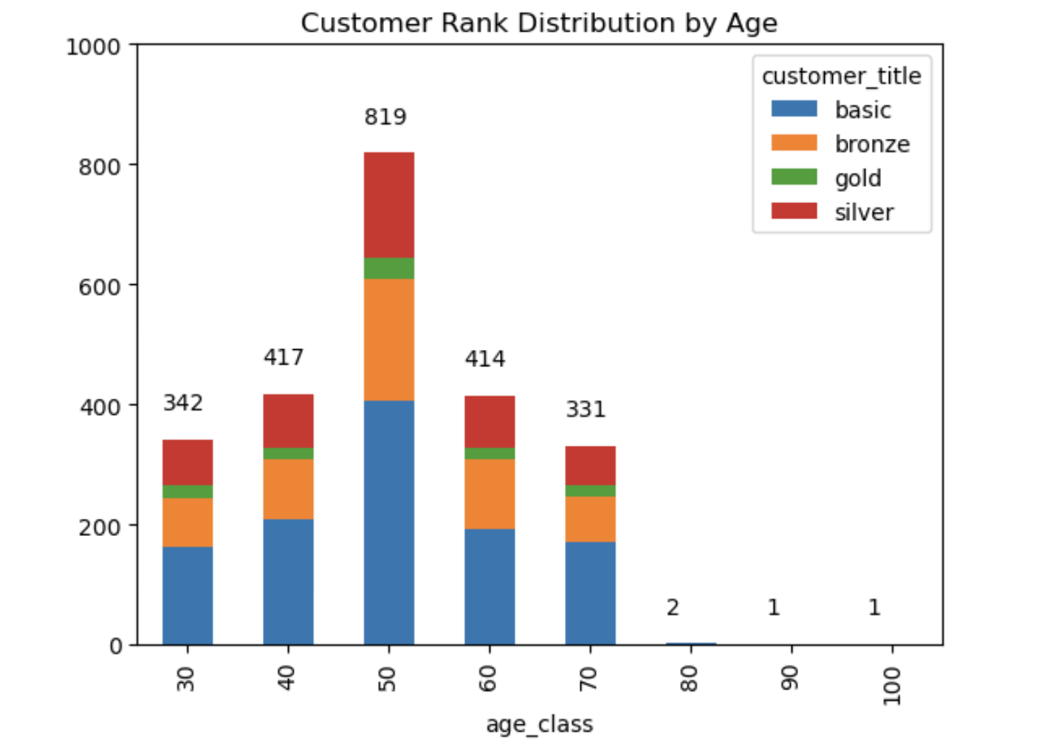
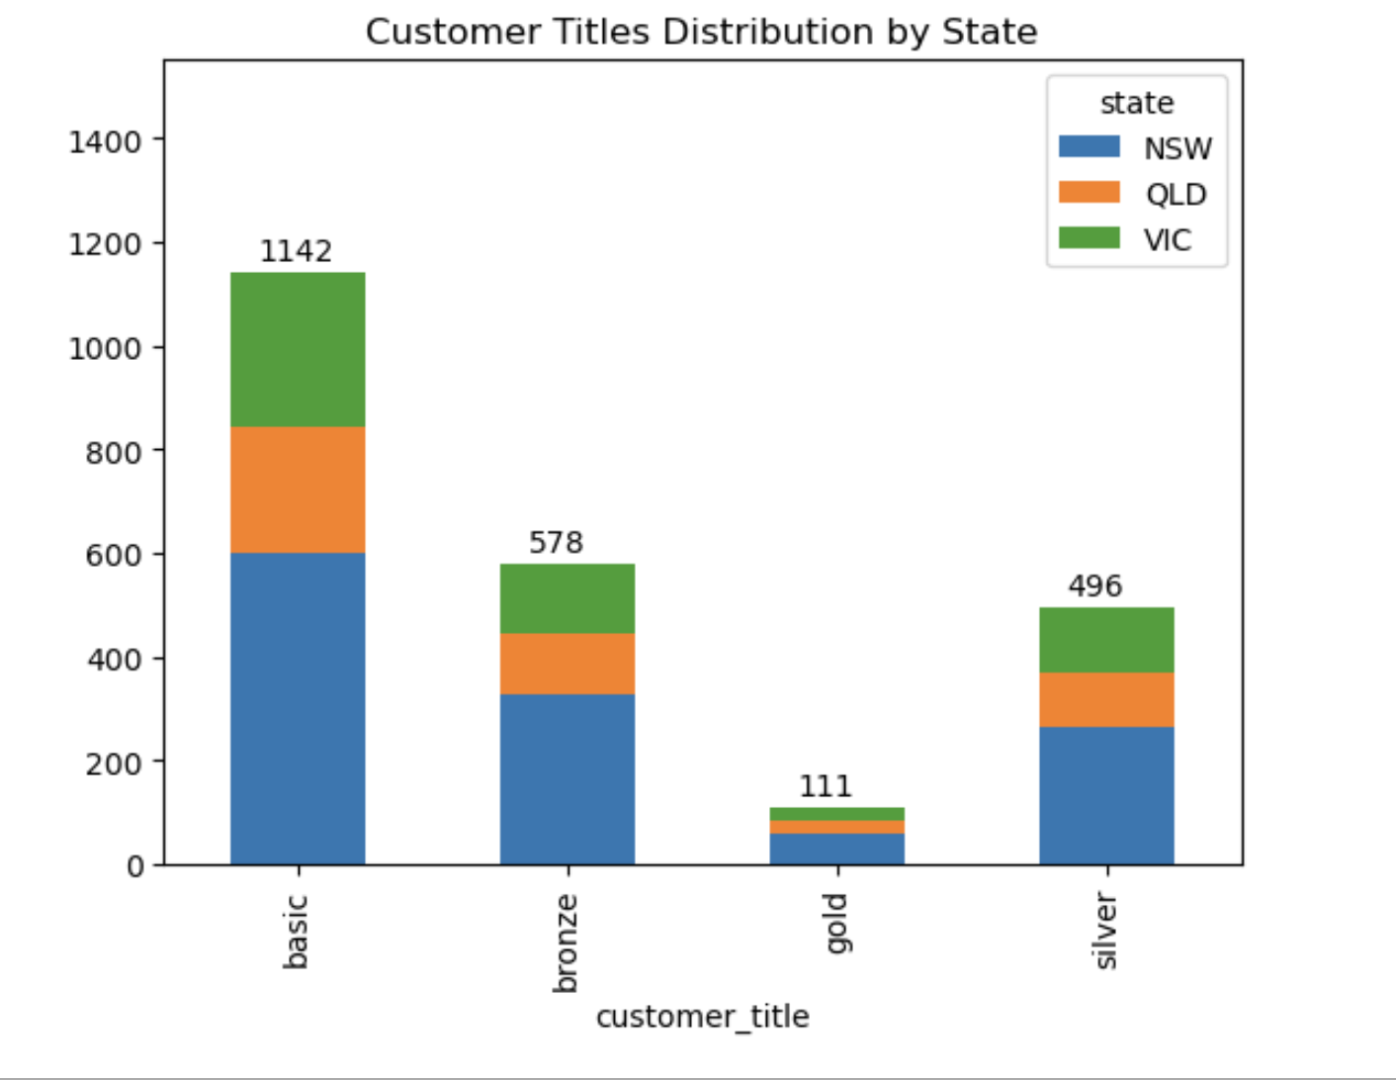
Note: The data and information in this document is reflective of a hypothetical situation and client. This document is to be used for KPMG Virtual Internship purposes only.
Data Exploration
Customer Rank Distributions
Place any supporting images, graphs, data or extra text here.

Slide 7
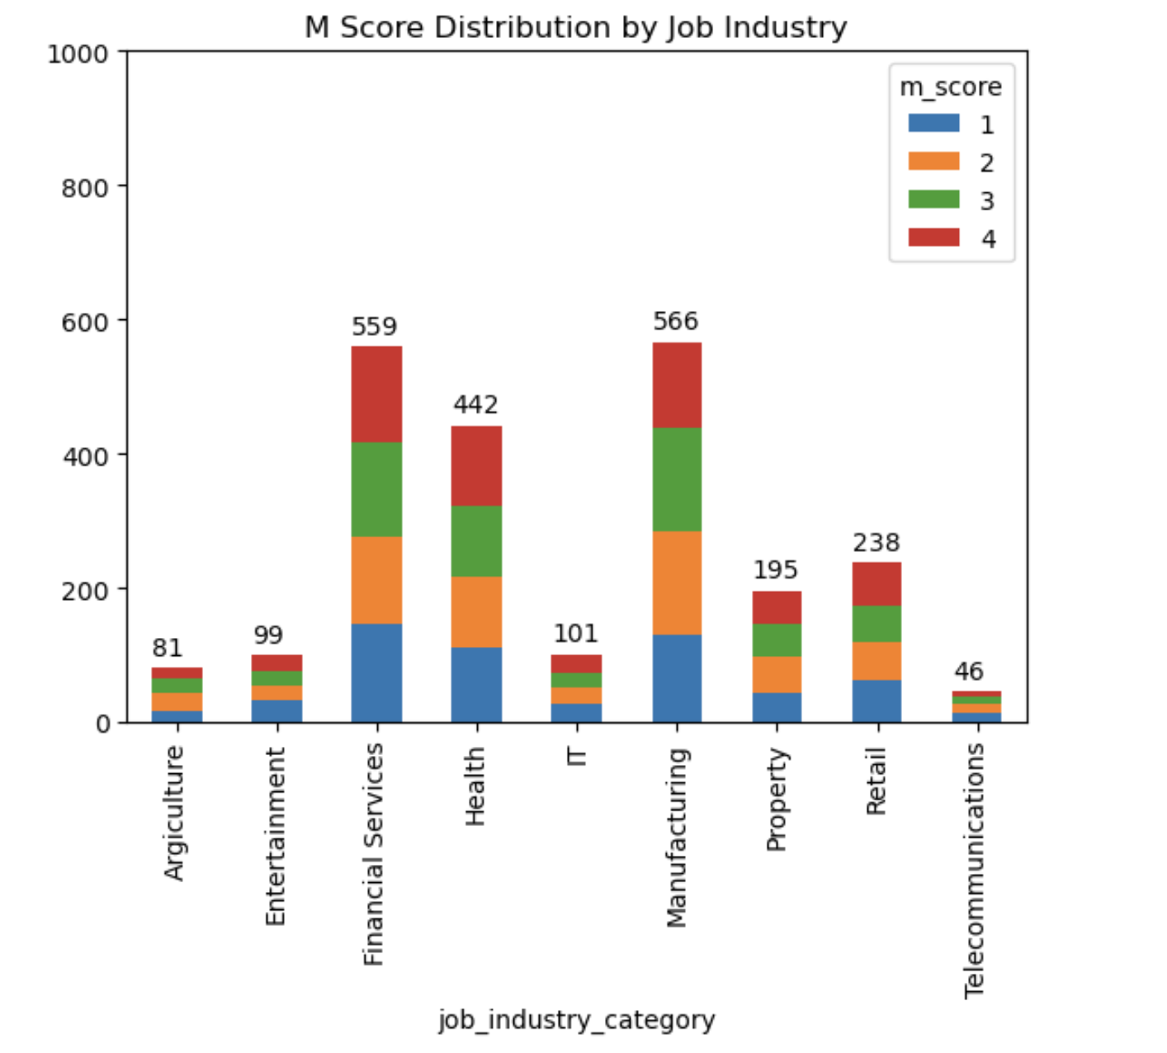
Note: The data and information in this document is reflective of a hypothetical situation and client. This document is to be used for KPMG Virtual Internship purposes only.
Data Exploration
M Scores Distribution by Job
Place any supporting images, graphs, data or extra text here.

Slide 8
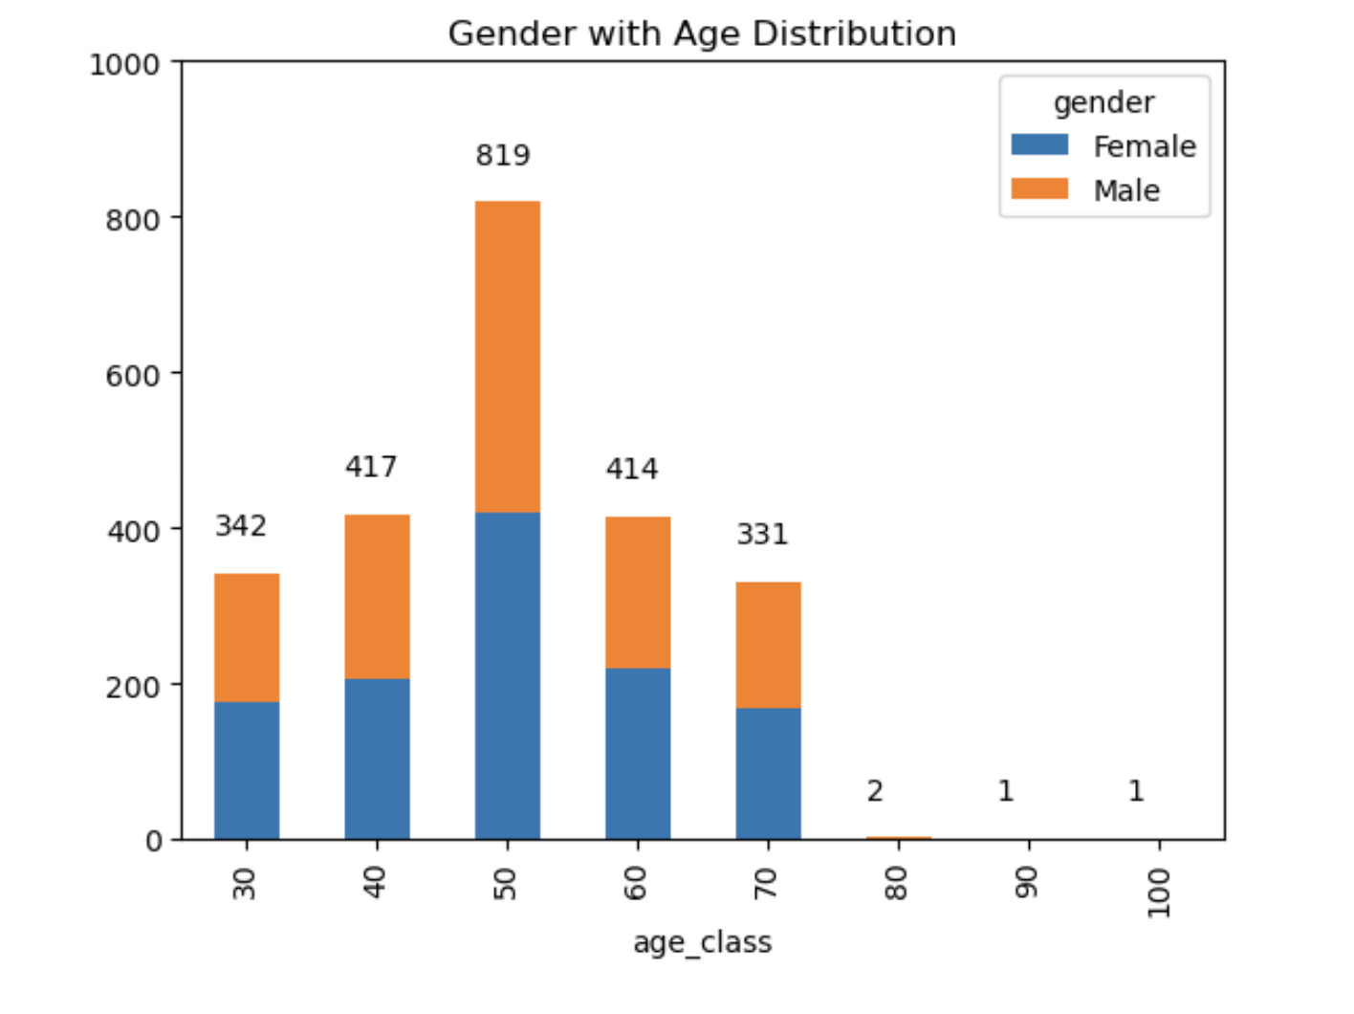
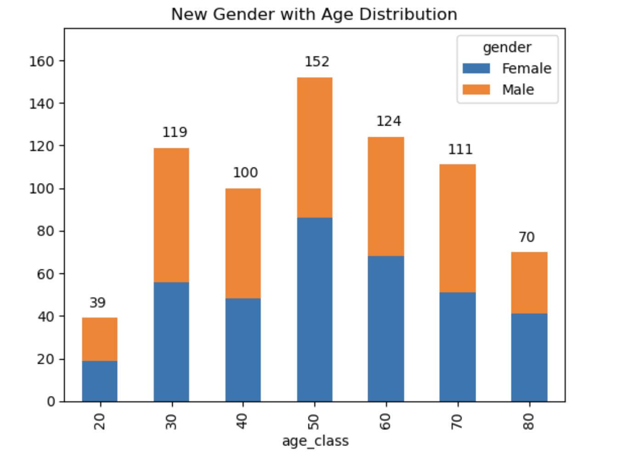
Note: The data and information in this document is reflective of a hypothetical situation and client. This document is to be used for KPMG Virtual Internship purposes only.
Data Exploration
Gender with Age Distribution
Place any supporting images, graphs, data or extra text here.
Place any supporting images, graphs, data or extra text here.

Slide 9
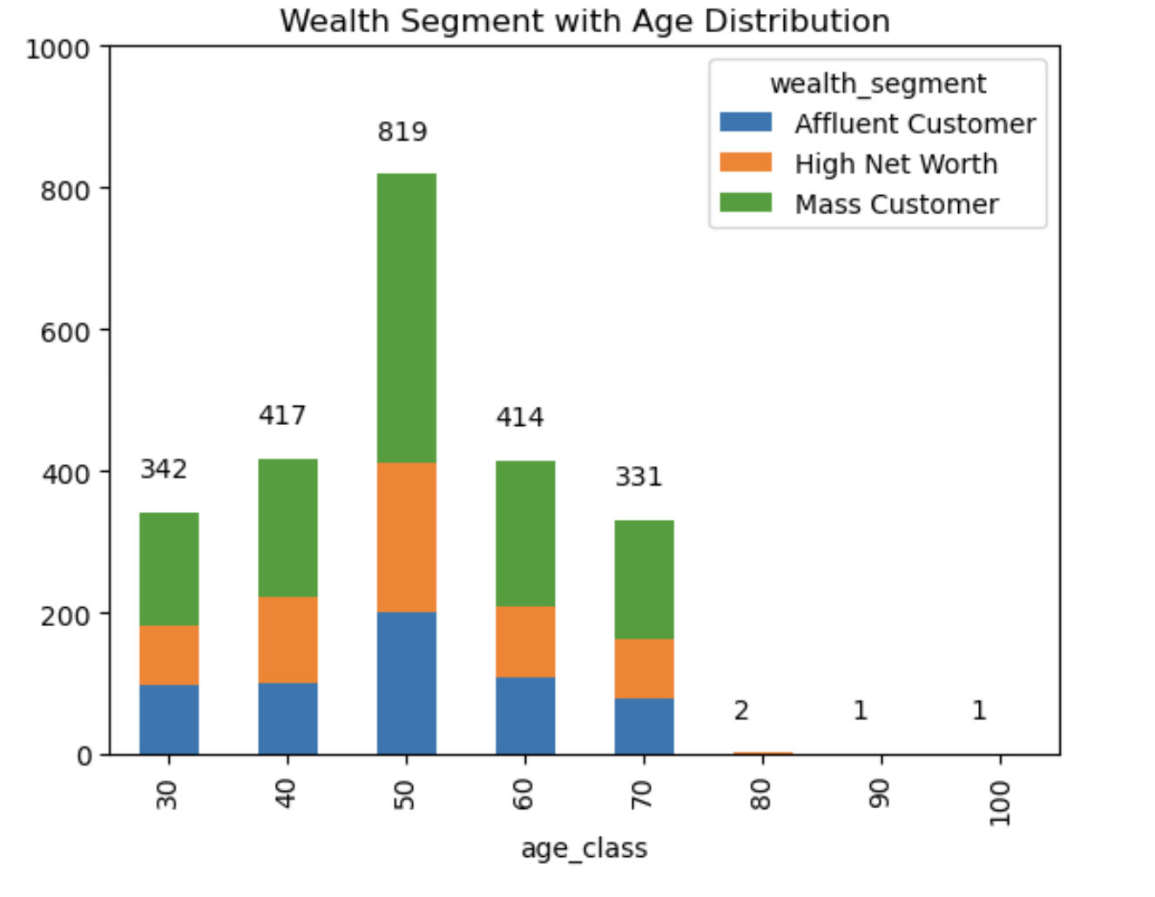
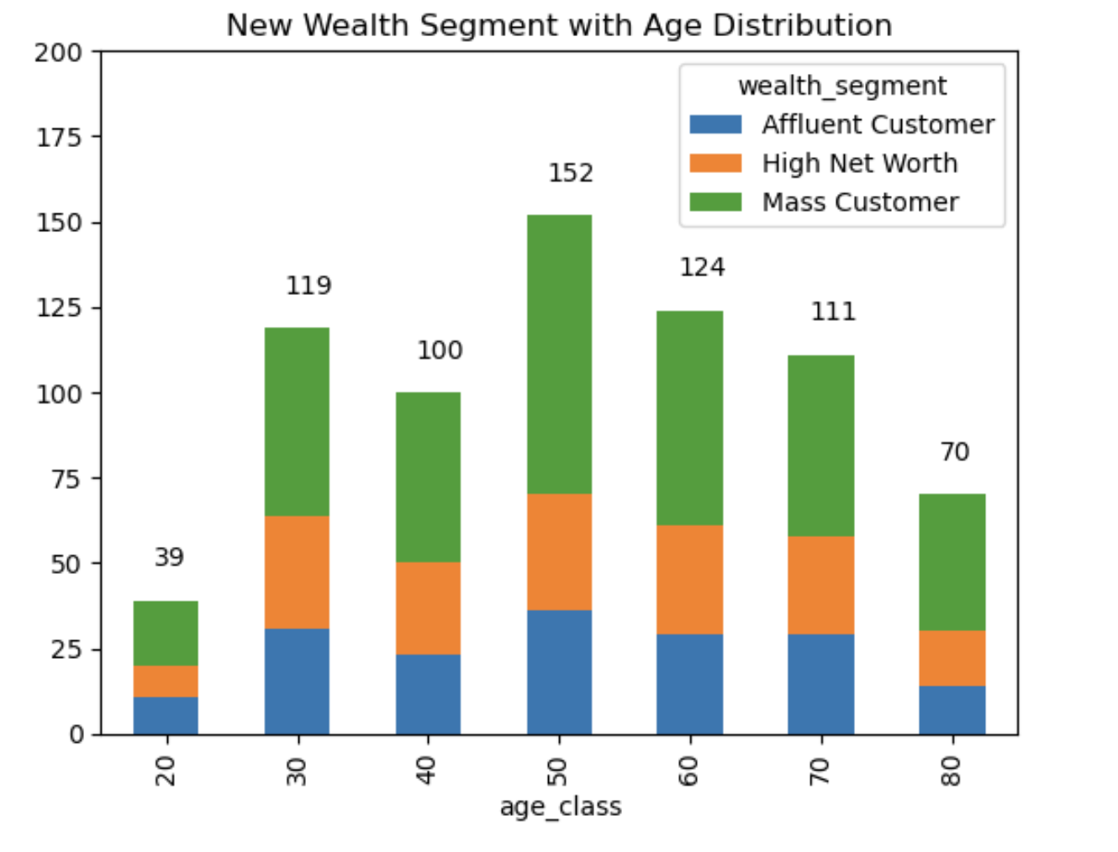
Note: The data and information in this document is reflective of a hypothetical situation and client. This document is to be used for KPMG Virtual Internship purposes only.
Data Exploration
Gender with Age Distribution
Place any supporting images, graphs, data or extra text here.
Place any supporting images, graphs, data or extra text here.

Slide 10
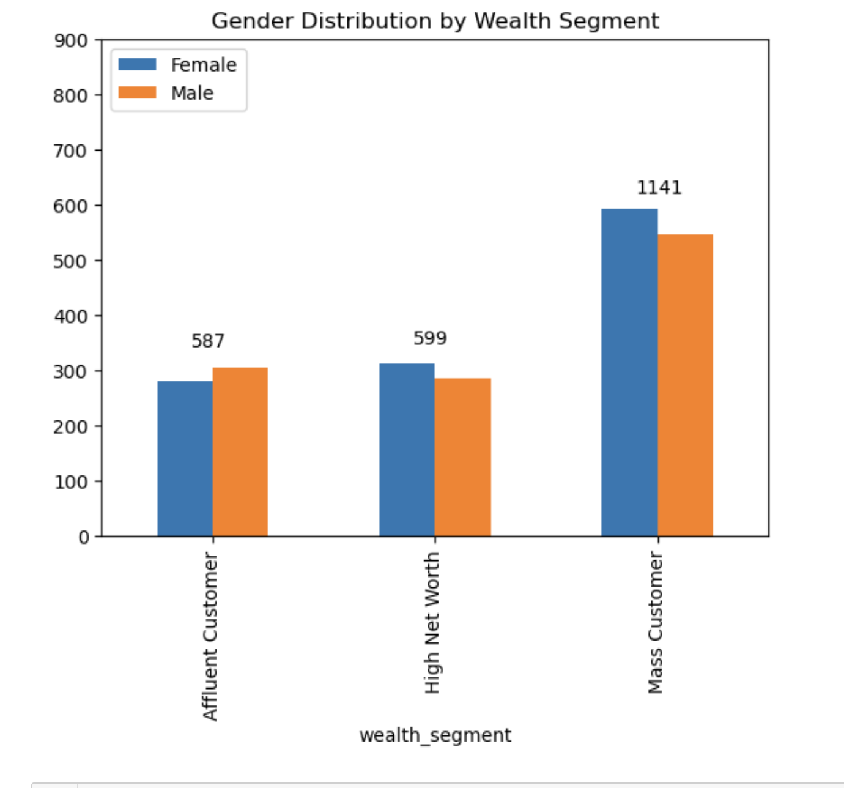
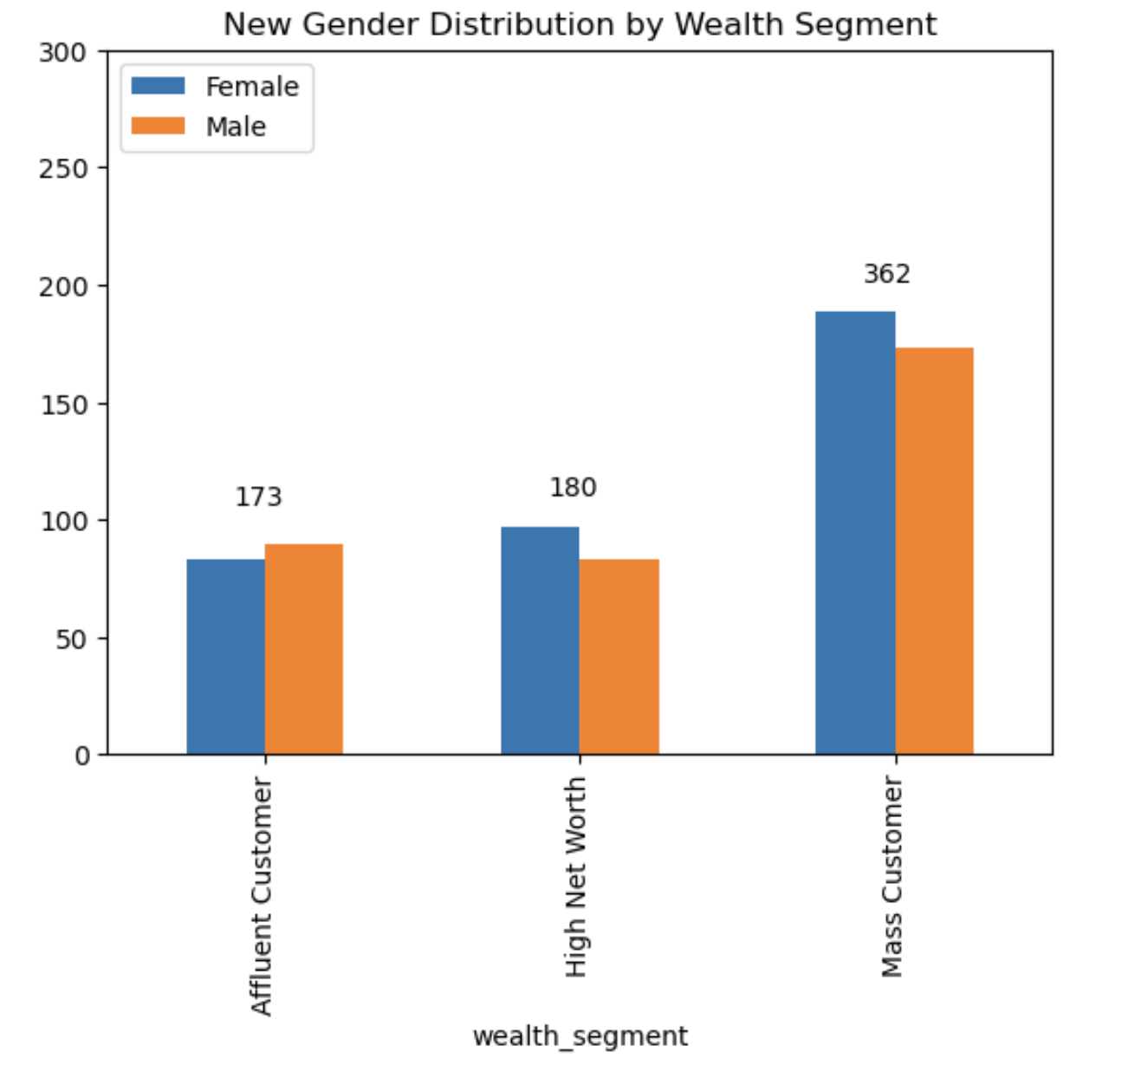
Note: The data and information in this document is reflective of a hypothetical situation and client. This document is to be used for KPMG Virtual Internship purposes only.
Data Exploration
Gender with Age Distribution
Place any supporting images, graphs, data or extra text here.
Place any supporting images, graphs, data or extra text here.

Slide 11
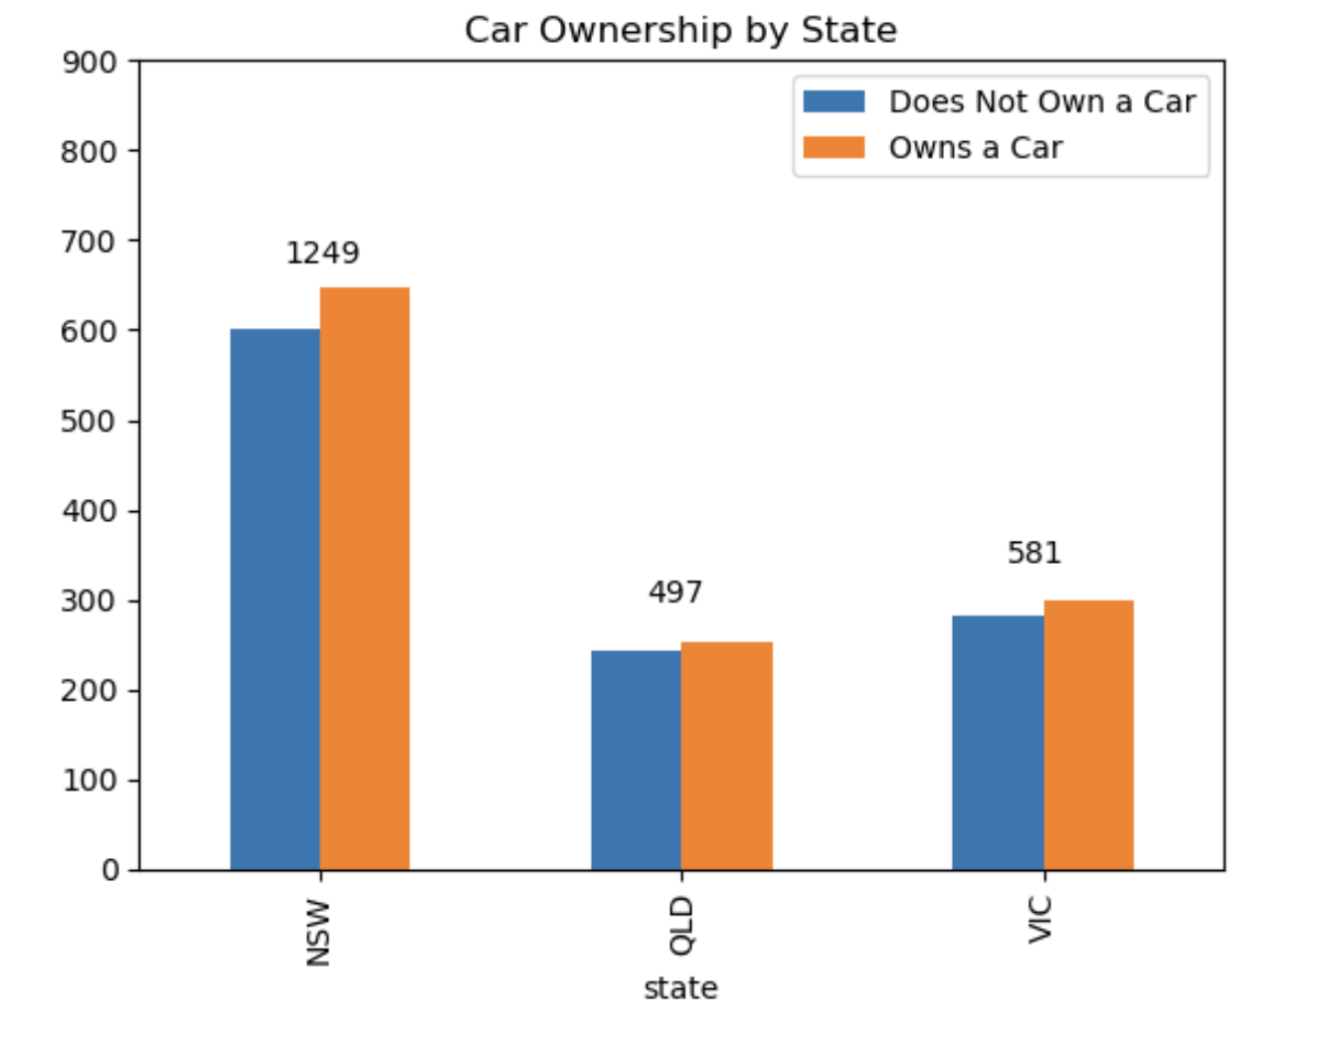
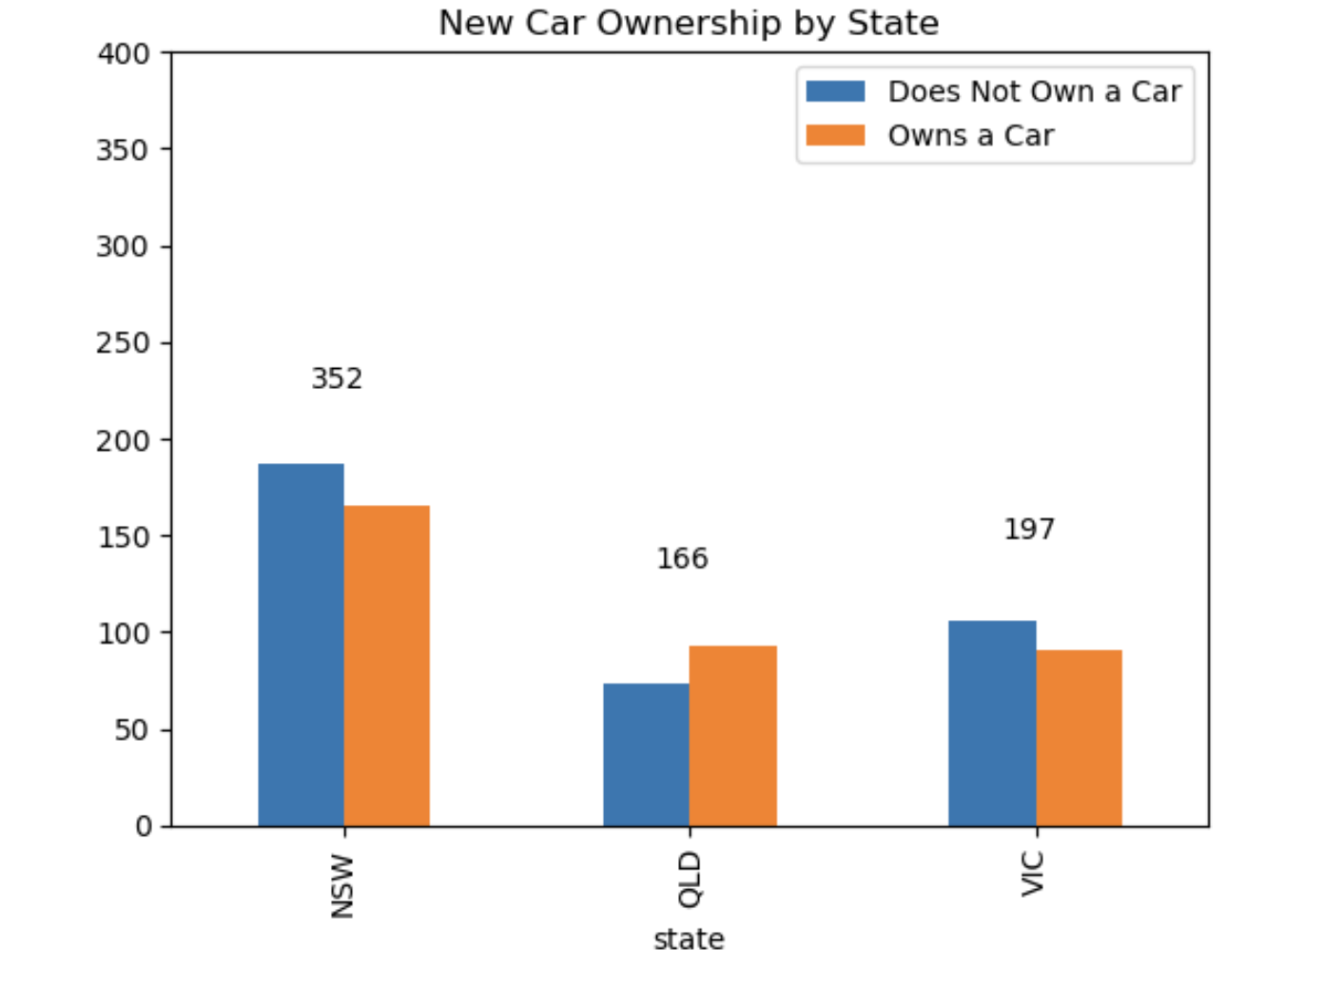
Note: The data and information in this document is reflective of a hypothetical situation and client. This document is to be used for KPMG Virtual Internship purposes only.
Data Exploration
Gender with Age Distribution
Place any supporting images, graphs, data or extra text here.
Place any supporting images, graphs, data or extra text here.

Slide 12
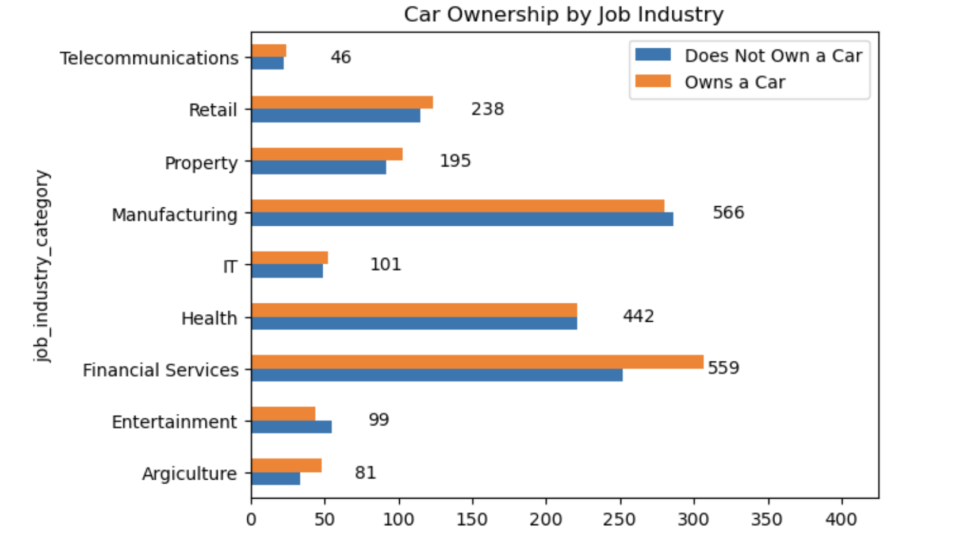
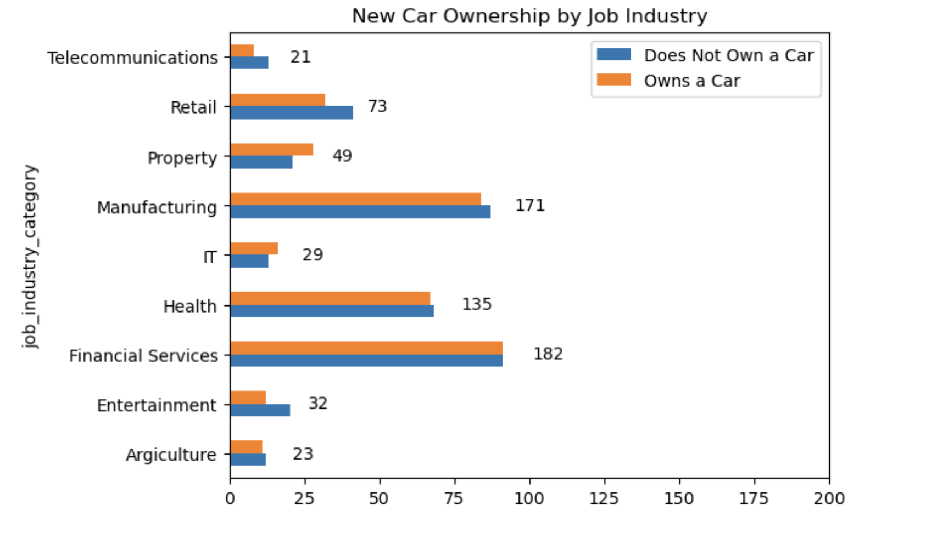
Note: The data and information in this document is reflective of a hypothetical situation and client. This document is to be used for KPMG Virtual Internship purposes only.
Data Exploration
Gender with Age Distribution
Place any supporting images, graphs, data or extra text here.
Place any supporting images, graphs, data or extra text here.

Slide 13
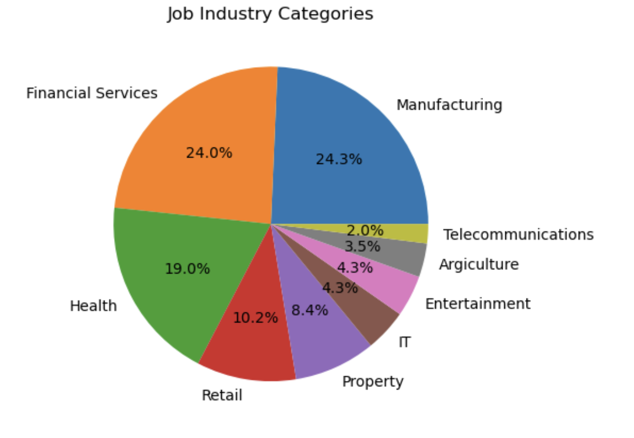
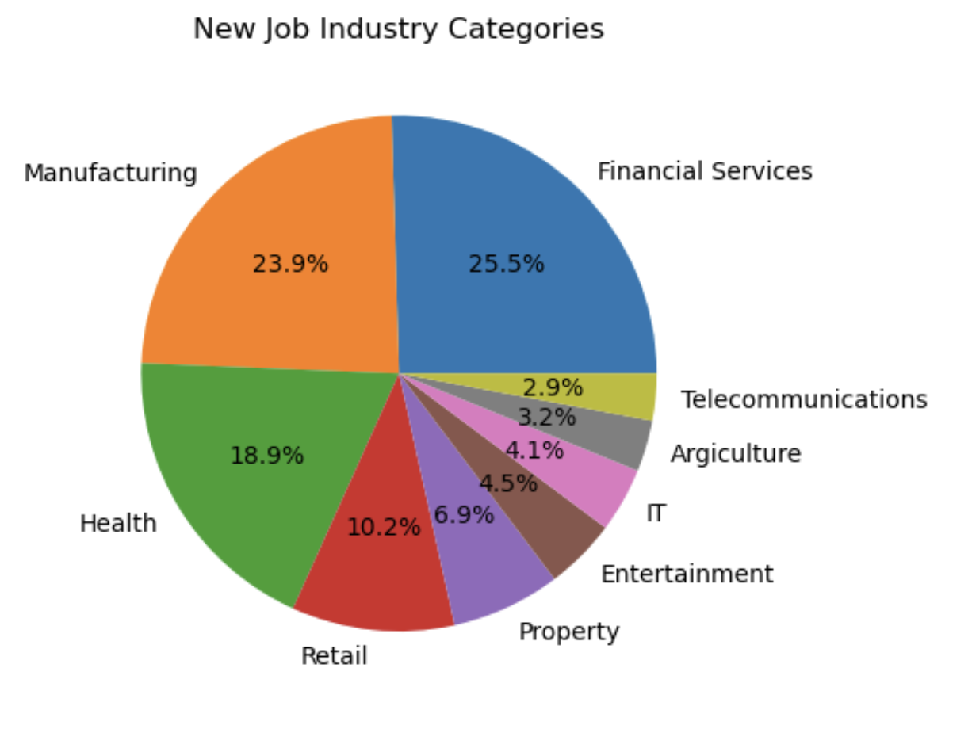
Note: The data and information in this document is reflective of a hypothetical situation and client. This document is to be used for KPMG Virtual Internship purposes only.
Data Exploration
RFM Analysis
Place any supporting images, graphs, data or extra text here.

Slide 14
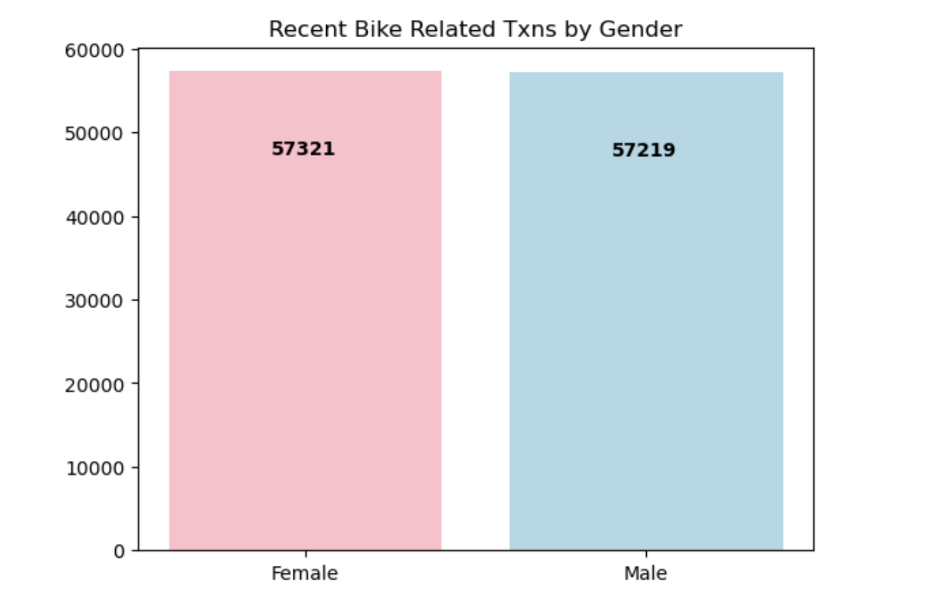
Note: The data and information in this document is reflective of a hypothetical situation and client. This document is to be used for KPMG Virtual Internship purposes only.
Data Exploration
Place headline insight or information here. This should be the most important point for this slide.
Place any information about this point here.
Place any supporting images, graphs, data or extra text here.

Slide 15
Note: The data and information in this document is reflective of a hypothetical situation and client. This document is to be used for KPMG Virtual Internship purposes only.
Model Development
RFM Analysis
Recency
The last day on which a customer performed a transaction was taken as the recency parameter.
Customers were divided into 4 quartiles and given a R_Score.
Frequency
The frequency of transactions done by a particular customer was taken as the frequency parameter.
Customers were divided into 4 quartiles and given a F_Score.
Monetary Value
The average profit per customer was taken as the monetary value parameter.
Customers were divided into 4 quartiles and given a M_Score.

Slide 16
Note: The data and information in this document is reflective of a hypothetical situation and client. This document is to be used for KPMG Virtual Internship purposes only.
Model Development
RFM Analysis

Slide 17
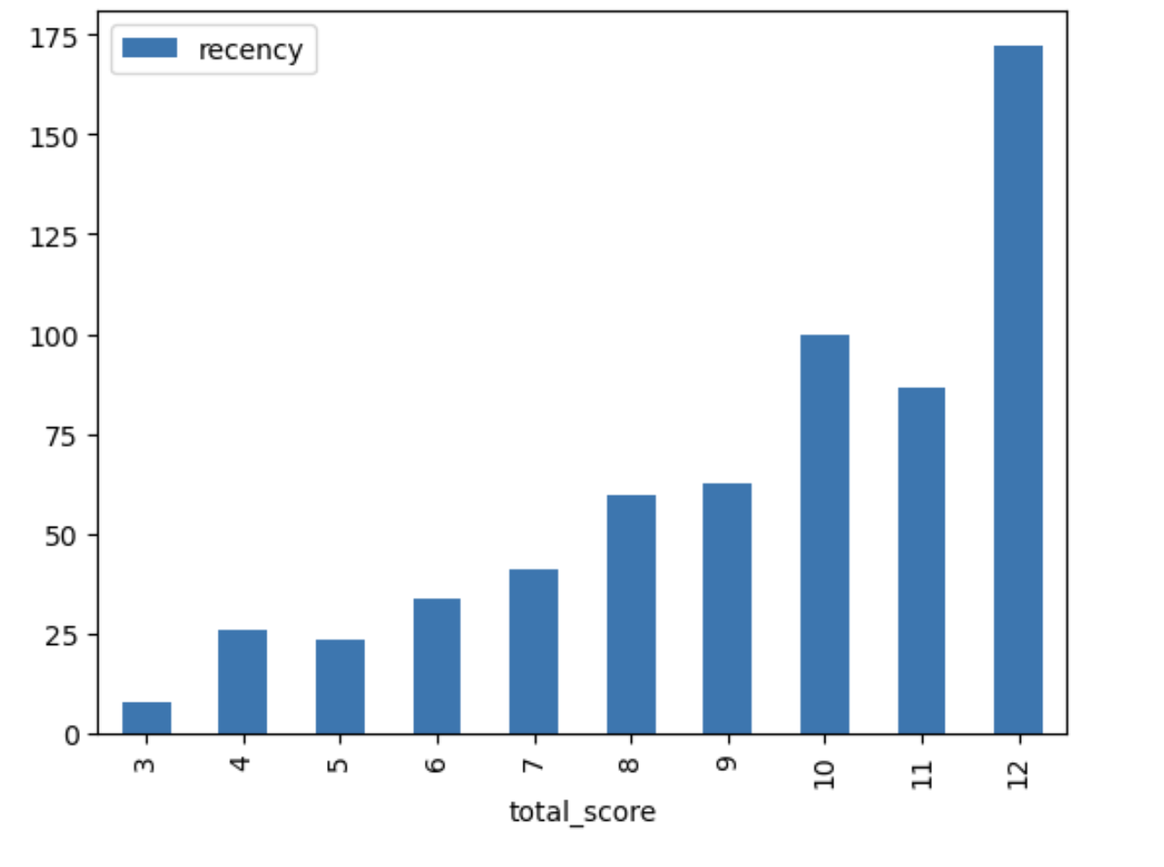
Note: The data and information in this document is reflective of a hypothetical situation and client. This document is to be used for KPMG Virtual Internship purposes only.
Model Development
RFM Analysis

Slide 18
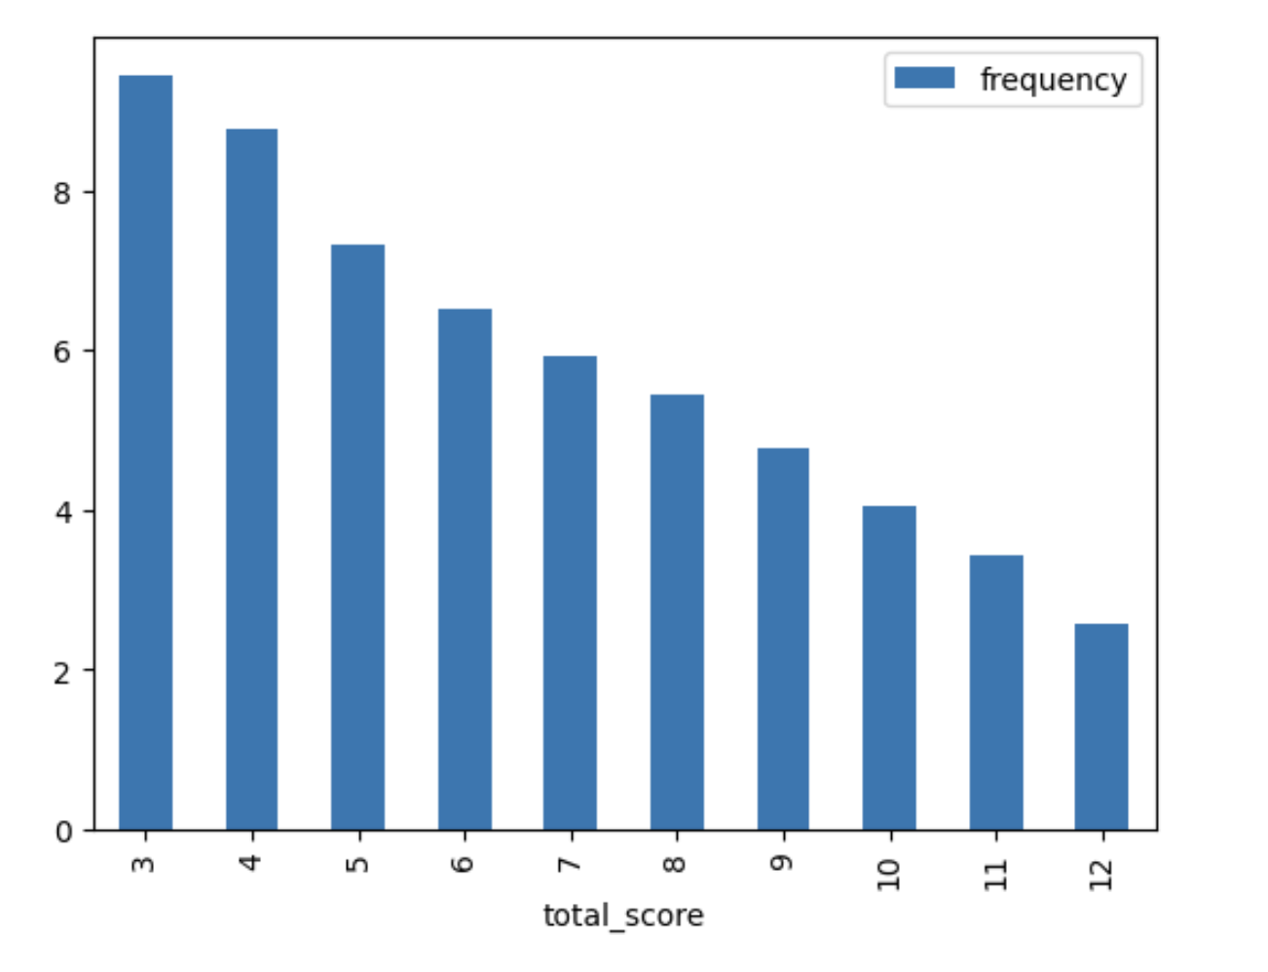
Note: The data and information in this document is reflective of a hypothetical situation and client. This document is to be used for KPMG Virtual Internship purposes only.
Model Development
RFM Analysis

Slide 19
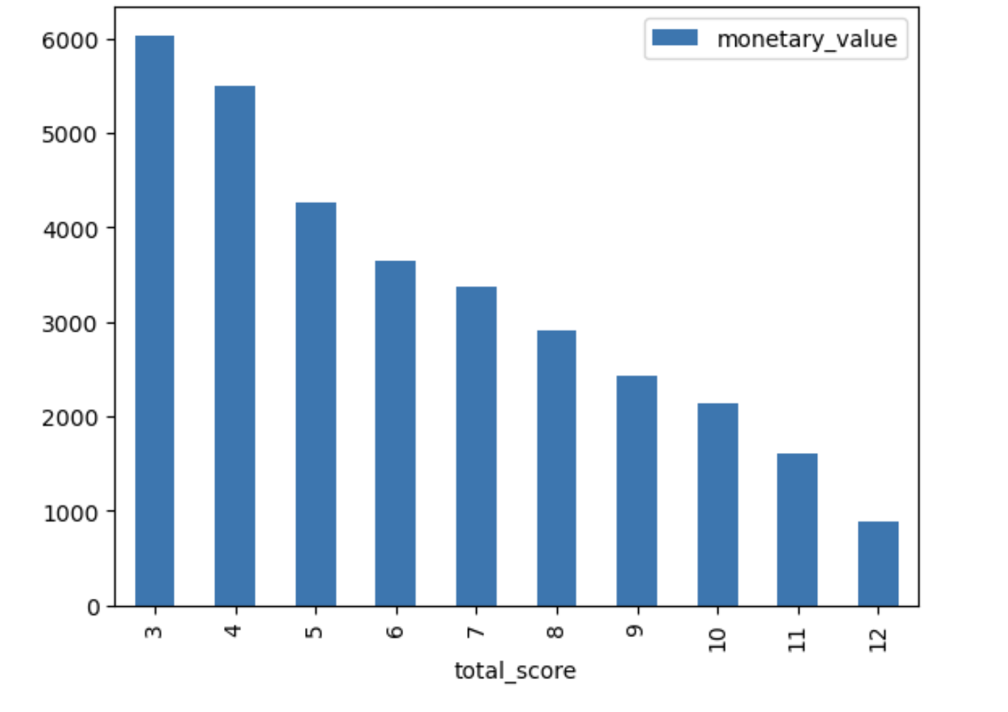
Note: The data and information in this document is reflective of a hypothetical situation and client. This document is to be used for KPMG Virtual Internship purposes only.
Model Development
RFM Analysis

Slide 20
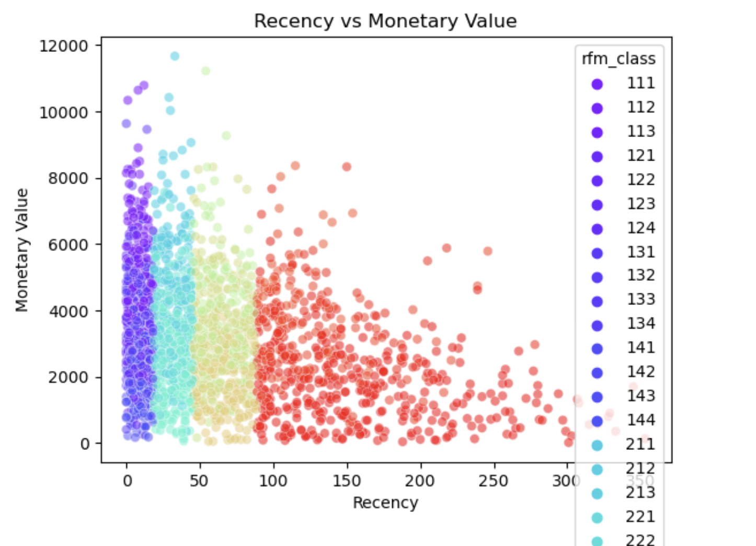
Note: The data and information in this document is reflective of a hypothetical situation and client. This document is to be used for KPMG Virtual Internship purposes only.
Model Development
RFM Analysis

Slide 21
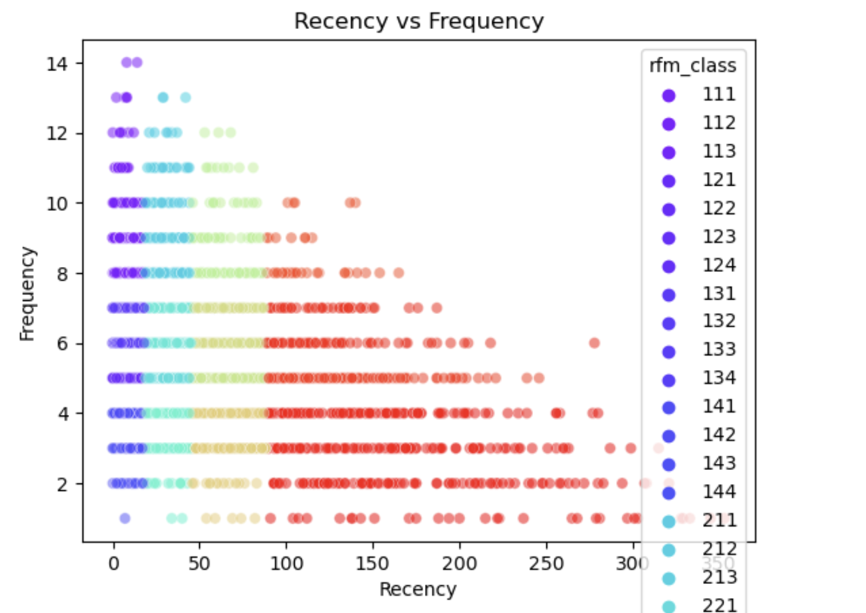
Note: The data and information in this document is reflective of a hypothetical situation and client. This document is to be used for KPMG Virtual Internship purposes only.
Model Development
RFM Analysis

Slide 22
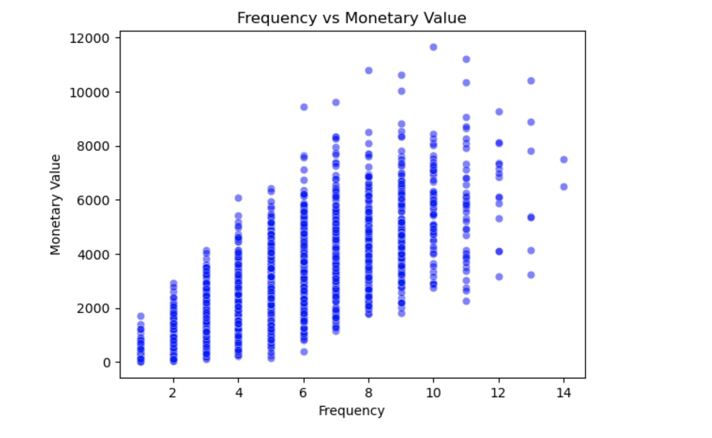
Note: The data and information in this document is reflective of a hypothetical situation and client. This document is to be used for KPMG Virtual Internship purposes only.
Model Development
RFM Analysis

Slide 23
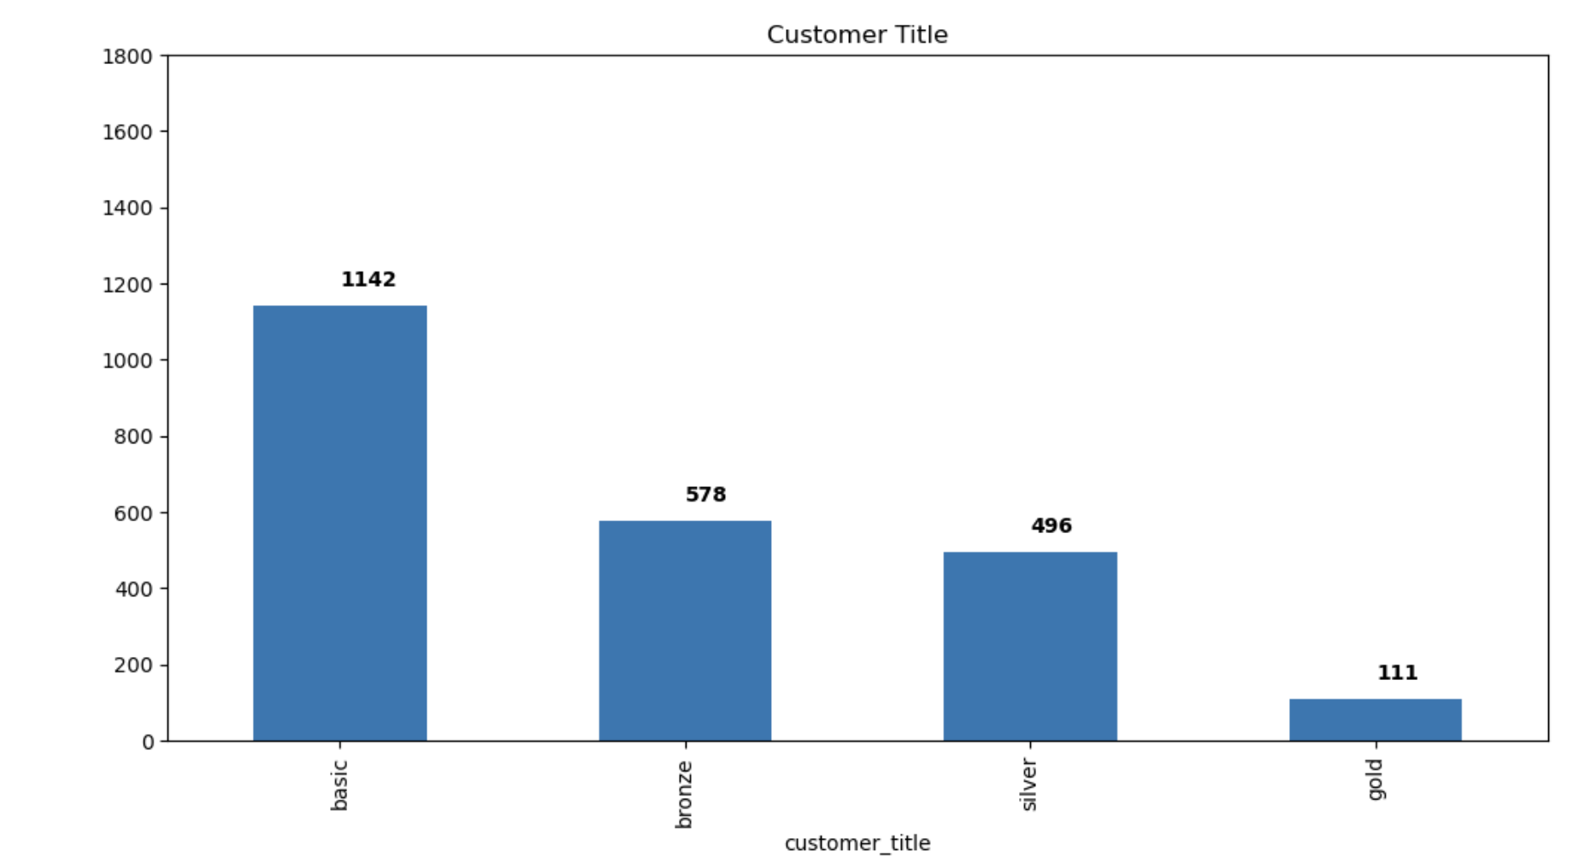
Note: The data and information in this document is reflective of a hypothetical situation and client. This document is to be used for KPMG Virtual Internship purposes only.
Model Development
RFM Analysis

Slide 24
Note: The data and information in this document is reflective of a hypothetical situation and client. This document is to be used for KPMG Virtual Internship purposes only.
Interpretation
Place headline insight or information here. This should be the most important point for this slide.
Place any information about this point here.
Place any supporting images, graphs, data or extra text here.

Slide 25
Note: The data and information in this document is reflective of a hypothetical situation and client. This document is to be used for KPMG Virtual Internship purposes only.
Appendix

